Slide 1
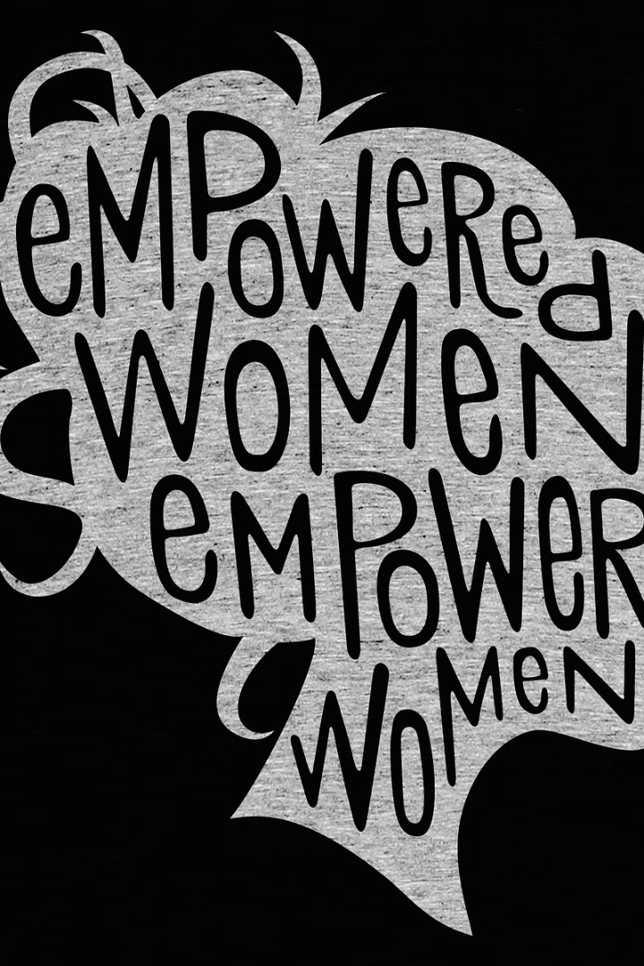


Introduction to the Topic of Female
Exploring the multifaceted aspects of femininity, from historical footprints to present-day achievements.
by Kritika Kumari

Slide 2
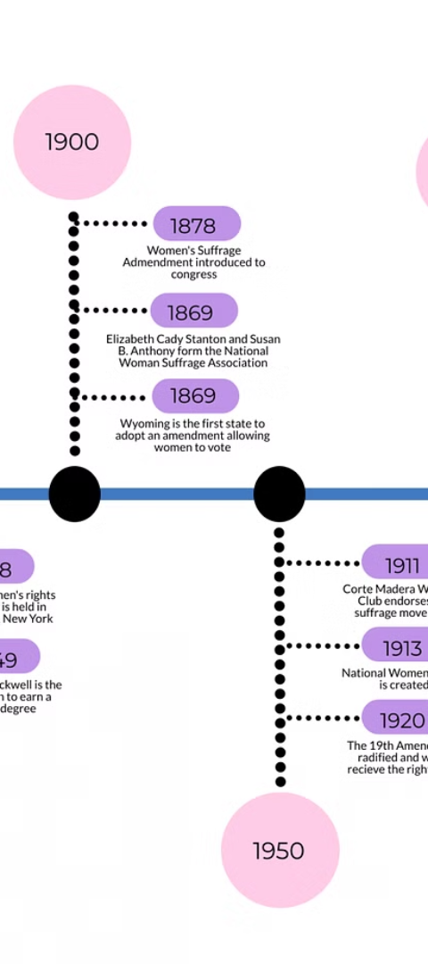
Historical Context and Milestones
1
Struggle for Rights
Fascinating journey of women's rights from the suffragette movement to equal opportunities.
2
Breaking Barriers
Notable milestones in history, highlighting courageous women who defied societal norms.

Slide 3

Gender Equality and Women's Rights
1
Equal Opportunities
2
Reproductive Rights
Advocacy for fair treatment in education, employment, and leadership roles.
Empowerment and autonomy in making informed decisions about health and family planning.
3
Legal Reforms
Efforts to ensure gender-based laws protect the rights and dignity of women.

Slide 4
Female Representation in Various Fields
Science & Technology
Arts & Culture
Business & Leadership
Highlighting contributions and breakthroughs by female scientists and technologists.
Celebrating creativity and impact of women in art, literature, and cultural expression.
Exploring women's influence and trailblazing initiatives in business and management.

Slide 5
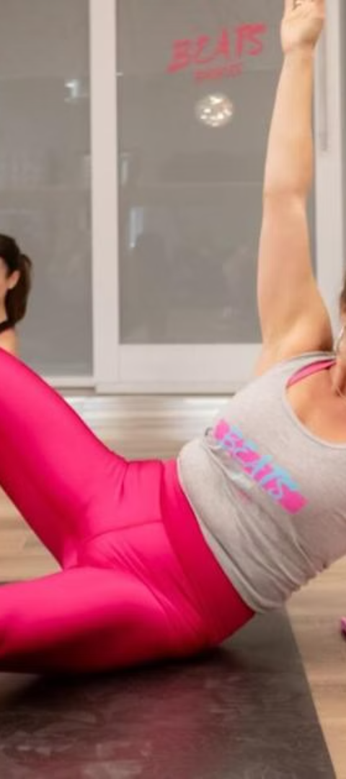



Challenges Faced by Women
Gender Discrimination
Persevering through prejudices and stereotypes to achieve true equality.
Work-Life Balance
Navigating dual responsibilities and societal expectations with resilience.
Health Disparities
Striving to overcome gender-specific health challenges and access equal healthcare.

Slide 6

Empowering Women and Promoting Gender Diversity
Education Initiatives
Corporate Inclusion
Policy Advocacy
Investing in educational programs to empower and uplift women of all ages.
Promoting diverse and inclusive workplaces to harness the power of collective talents.
Advocating for policies and laws that foster gender equality and female empowerment.

Slide 7
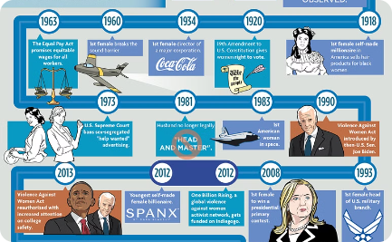
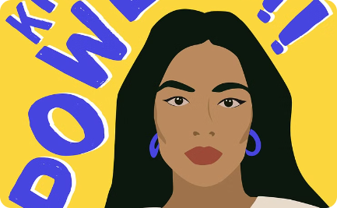
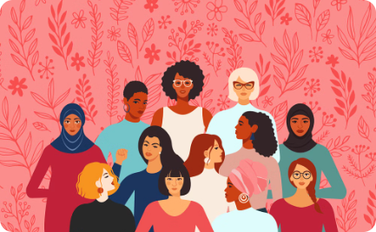
Celebrating Female Achievements
Inspiring Leaders
Artistic Contributions
Social Impact
Recognizing influential women who inspire change through their remarkable achievements.
Saluting female artists, performers, and creators who shape culture and society.
Spotlighting women driving positive change in communities and global movements.

Slide 8
Conclusion and Call to Action
8
150K
Global Impact
Inspired Lives
Let's continue to support, uplift, and empower women worldwide for a more inclusive and equitable future.

